Slide 1

Introduction
My name is Maryjane Chidimma Ejezie, a proficient Data Analyst.

Slide 2
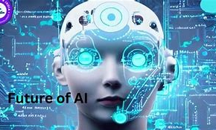
PROJECT TOPIC:GLOBAL AI CONTENT IMPACT
What is Artificial Intelligence (AI)?
Artificial intelligence is all about making machine think and act like human, especially in term of learning , problem solving and decision making.

Slide 3
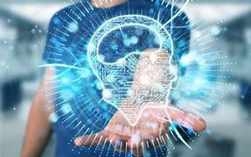
OBJECTIVES
Understanding AI Role: The role the play globally and how important it is.
Identifying AI opportunities: Exploring the benefit of AI in Globally and the most countries that is making use of it.
Assessing the risk of using AI: Knowing the risk of AI and how it have affected so many industries
Mitigating Negative Impact: Knowing the negative impact and how to minimize AI negative effects on content ecosystem
Fostering Innovation: To encourage innovation in AI-driven learning , problem solving and decision making.

Slide 4
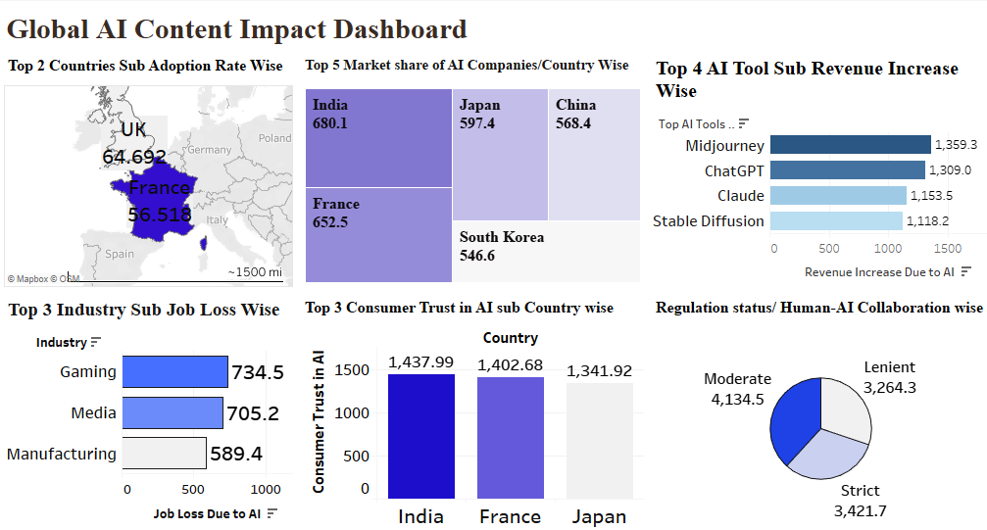

Slide 5
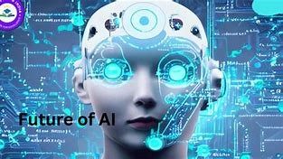
Key Findings
The top 2 countries with adoption rate are UK (64.692) and FRANCE (56.518)
The top 5 Market share AI companies are India(680.1), France(652.5), Japan(597.4), China(568.4) and South Koria(546.6).
The 4 top AI Tool sub-Revenue Increase are Midjourney(1,359.3), ChatGPT(1,309.0), Claude(1,153.5) and Stable Diffusion (1,118.2)
Top 3 industries that Loss their Job due to AI are Gaming industries( 734.5), Media(705.2) and Manufacturing(589.4)
The top 3 consumer Trust in AI are India(1,437.99), France(1,402.68) and Japan(1,341.92)
The Regulation Status sub-human collaboration are Moderate(4,134.5), Strict(3,421.7) and Lenient(3,264.3)

Slide 6
Improvement/Suggestion
AI is improving through advancements in data collection, processing, and analysis, leading to better decision-making, enhanced automation, and improved user experiences.
AI model improvement is an ongoing process. After forming hypotheses and selecting potential solutions, experimentation and iteration are key to refining the model.
Model retraining: regularly retrain the model with new data, feature updates, or algorithm adjustments to ensure it stays relevant and adapts to changing conditions.
Automated monitoring and feedback loops: use automated systems to provide continuous performance feedback, enabling quick adjustments and rapid iteration on improvements.

Slide 7
Recommendation
Recognize the social risks implied by artificial intelligence: first step in resolving a problem is to recognize that it exists. According to EIU, the risk for the future of employment and privacy posed by artificial intelligence is undeniable. Faced with this reality, there is no room for complacency or resignation.
Explain, educate and boost transparency: to demand blind faith in algorithms is a sure road to misinformation and distortion about artificial intelligence. “The biggest challenge facing AI is the possible lack of confidence in the technology due to a lack of transparency on how machines arrive at their decisions”.

Slide 8

Conclusion
The Future of AI in Education is Bright and full of possibilities. As the society continue to embrace this technology, it's crucial that we remain mindful of its impact and work address the challenges that comes with its evolution. With the potential to transform the way higher education institutions teach and learn.

Slide 9
Question /answer time
Thank you

